Slide 1
Project 3
Graduation Rates Analysis Project – MARICOPA COUNTY, Az
High Schools (2023)
Priscilla Miller
Javier Reyes Hernandez
Notes:
Good evening, everyone. Today, we'll be presenting our Graduation Rates Analysis Project focused on Maricopa County high schools for the year 2023. We initially considered taking a data engineering approach, but we ultimately decided to focus on the data visualization track. This allowed us to analyze and present the data in a way that highlights key trends, gaps, and distributions, which can inform educational decision-makers

Slide 2
Agenda
Introduction
Tools and Platforms
Datasets Overview
Key Analytical Questions
Query Results and Visualizations
Conclusion

Slide 3
Introduction
Analyze the 2023 graduation rates in Arizona schools.
Focus on subgroup analysis (gender and other demographics).
Identify trends, gaps, and distributions to inform educational decisions.
Analyze the 2023 graduation rates in Arizona schools
Focus schools on Highest and Lowest graduation rates
Identify trends, gaps, and distributions to inform educational decision makers.
Notes:
The main objective of this project was to analyze the 2023 graduation rates in Arizona schools, specifically focusing on Maricopa County. We aimed to identify schools with the highest and lowest graduation rates, perform subgroup analysis across demographics like gender, and highlight any significant trends or gaps that could guide future educational strategies."

Slide 4
Tools and platforms
SQL: Used for data querying and analysis
Python & Jupyter Notebooks: For advanced analysis and optional visualizations.
Database: PostreSQL served as our database management system
Openstreetmap, Matplotlib. For map and charts visualization.
Notes:
We utilized various tools and platforms for this project:
SQL for data querying and analysis,
Python & Jupyter Notebooks for advanced analysis and optional visualizations,
PostgreSQL served as our database management system,
And we used OpenStreetMap along with Matplotlib for map and charts visualization."

Slide 5
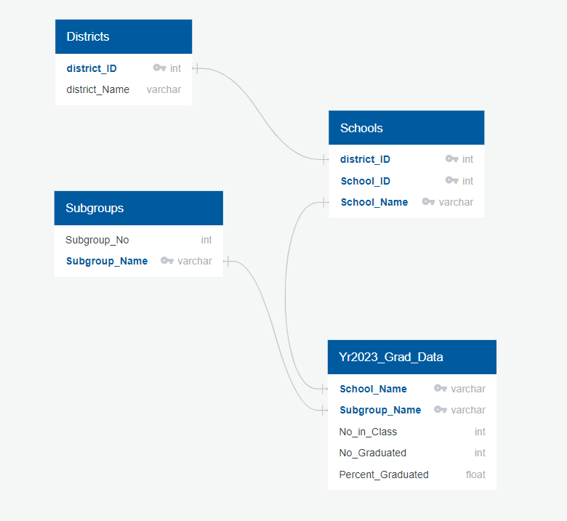
Datasets overview
First, created an ERD to create a SQL database from Excel data sheets.

Slide 6
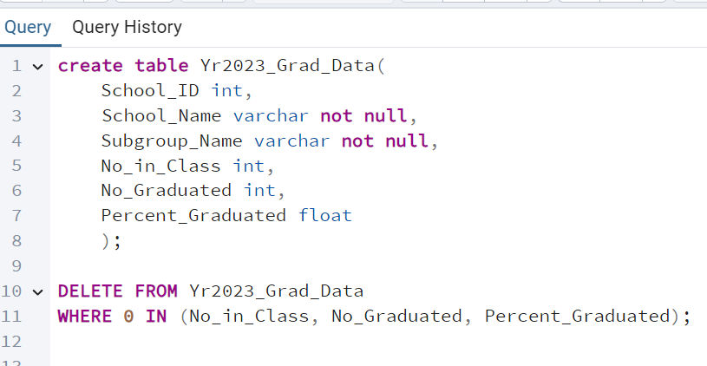
Datasets overview
We then proceeded to clean the data by removing asterisks, dropping columns that we thought weren’t needed for our analysis and exported to CSV.
Once in CSV we entered coded to delete Zeros.

Slide 7
KEY ANALYTICAL QUESTIONS
Overall Graduation Rate: What is the overall graduation rate across all schools for Maricopa County in 2023?
Top Schools: Which schools had the highest graduation rates?
Lowest Schools: Which schools had the lowest graduation rates?
Graduation Rate by Subgroup: How does the graduation rate vary by subgroups?
Gaps in Graduation Rates: Which schools show the largest gaps between subgroups?

Slide 8
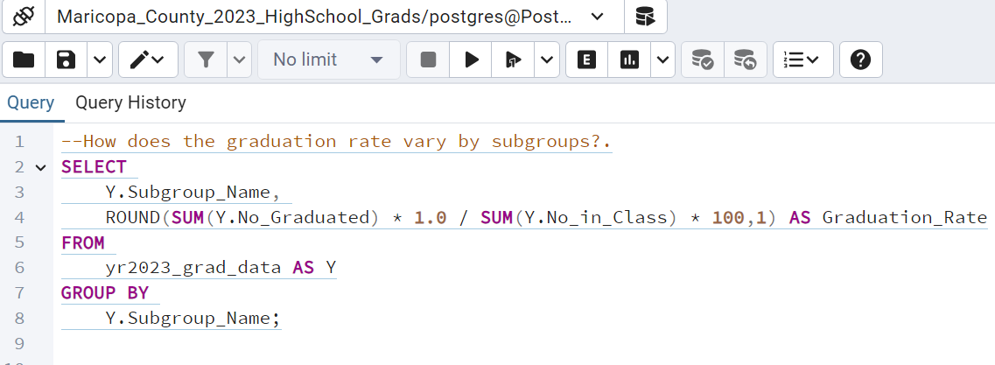
SQL Queries
We then used PostgreSQL and queried the database

Slide 9
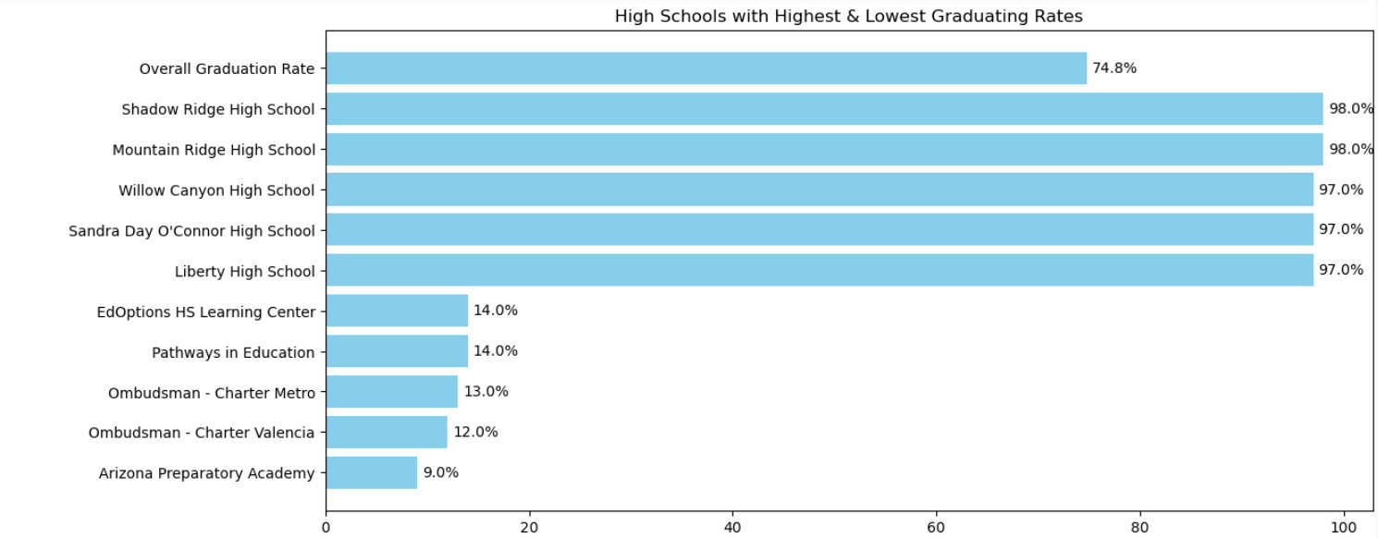
Results
In 2023, what was the overall graduation rate across all schools for Maricopa County in 2023?
Which schools had the highest & lowest graduation rates?
Notes:
For our first question, we found that the overall graduation rate across all schools in Maricopa County was 75%. We also identified the top-performing schools, such as Shadow Ridge and Mountain Ridge and those with lower graduation rates, like Arizona Preparatory Academy and Ombudsman charter Metro."

Slide 10
Interactive map
Which schools show the largest gaps between subgroups?
Maricopa County Map
Notes:
To provide a visual overview, we created an interactive map highlighting the schools across Maricopa County, with markers representing the graduation rate distributions. This map allows users to see geographic trends at a glance, such as [mention any noticeable patterns

Slide 11
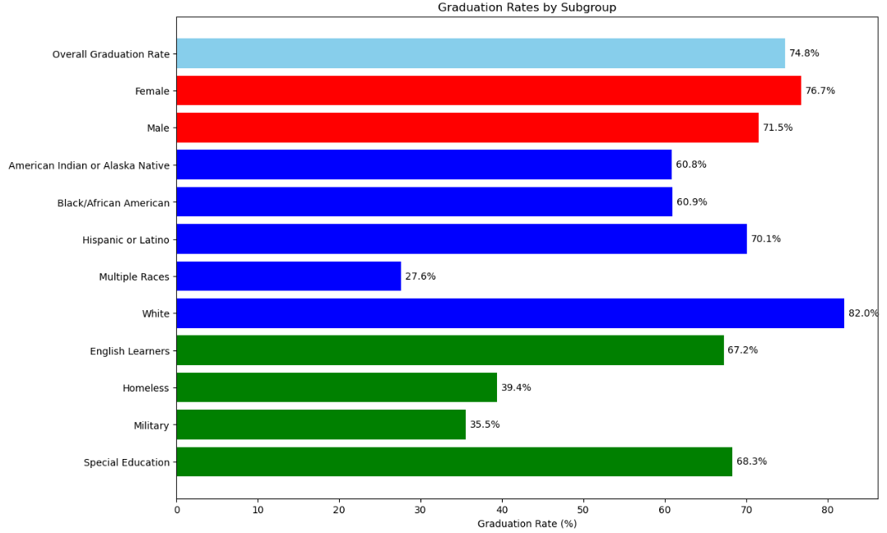
Results
How does the graduation rate vary by subgroups?

Slide 12
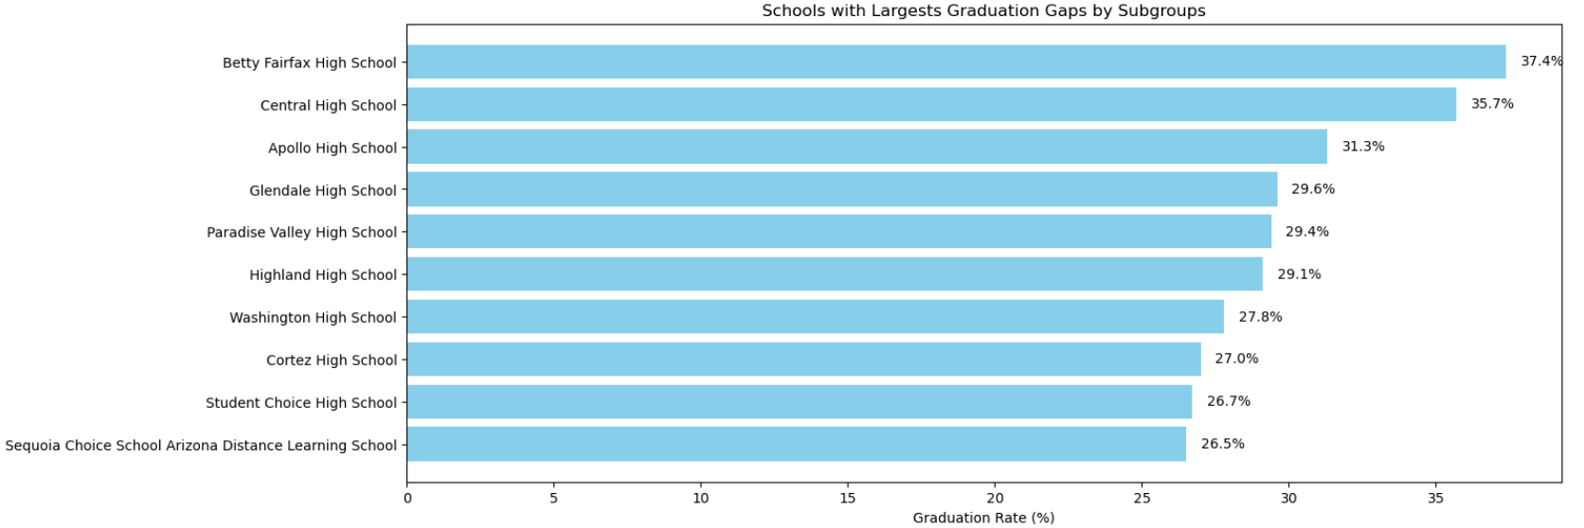
Results
Which schools show the largest gaps between subgroups?
Notes:
We also focused on identifying schools that showed the largest gaps between subgroups. Schools like [name schools] had significant variations in graduation rates among different demographics, indicating areas where targeted interventions might be needed."

Slide 13
Conclusion
Notes:
In summary, our analysis of the 2023 graduation rates across Maricopa County high schools provided valuable insights into overall performance, subgroup variations, and disparities among different schools. We identified schools excelling in graduation rates, showcasing practices that could be adopted by others, as well as those facing challenges that indicate areas for targeted improvement.
The analysis highlighted significant gaps between subgroups, suggesting that more focused efforts are needed to ensure equitable educational outcomes. By identifying these trends and distributions, we aim to inform educational decision-makers, helping them to allocate resources and implement strategies that improve graduation rates across all schools.
Our findings underscore the importance of data-driven approaches in understanding and addressing educational challenges, paving the way for informed strategies that can lead to a brighter future for students in Maricopa County

Slide 14
References
Arizona Department of Education.(2024). Cohort 2023 Four Year Graduation Rate Data..(Https://www.azed.gov/sites/default/files/2024/01/4Year_Grad_Rate_Cohort2023_publish%5B1%5D.xlsx)

